Slide 1
MAJOR PROJECT FINAL PRESENTATION
AUTOMATION OF AMAZON S3 OBJECT STORAGE USING PYTHON AND BOTO3 SDK
GROUP A7:
P. Jyothi Koushik (16241A0536)
B. Shiva Ram Reddy(16241A0503)
Akash Vulishetty(15241A05Z9)
G.P Vineeth Babu(15241A05D3)
INTERNAL GUIDE:
DR. P. CHANDRASEKHAR REDDY
PROFESSOR

Slide 2
PROJECT ABSTRACT
Amazon Web Services(AWS) is one of the most reliable, efficient, scalable cloud computing platforms available to modern developers today which offers variety of services to users. AWS provides a scalable object storage service to developers called AWS S3(Simple Storage Service). This S3 service offers incredible durability. This enables users and developers store their project code, configuration files and retrieve any quantity of data from the internet at anytime. It also offers high security and rapid data recovery also.
The main drawback of using S3 in AWS is the working developer should manually monitor the storage from adding to removing data and it is also a time-taking process given it’s security purposes. To create or delete the data bucket we need to manually go over all files and handle the process. This might lead to more human errors. The solution to this is by automating AWS services using Python and Boto3 (SDK for AWS) which helps us to create powerful scripts that help developers automatically do all the required tasks without any manual functioning. This helps save time and also manage all our data without any ambiguity.

Slide 3
EXISTING SYSTEM
In the current existing system, users like CLOUD DEVELOPERS store their valuable data like configuration files, modules, binaries etc on the AWS S3 Storage. Users who would like to upload data to the bucket (or) download files from the bucket (or) delete files need to perform every operation manually, they have to sign in, go to the respective bucket, traverse all the files and perform the operations. Every operation need to be manually confirmed by the user by typing the bucket name so that the operation could proceed. In this highly advancing world, developers don’t have the time to do the work manually. Also any other user than the root user i.e. (IAM User) cannot perform the operations as long as security credentials are cleared for them. This will lead to slowing of work and obstacle in the progress of development.

Slide 4
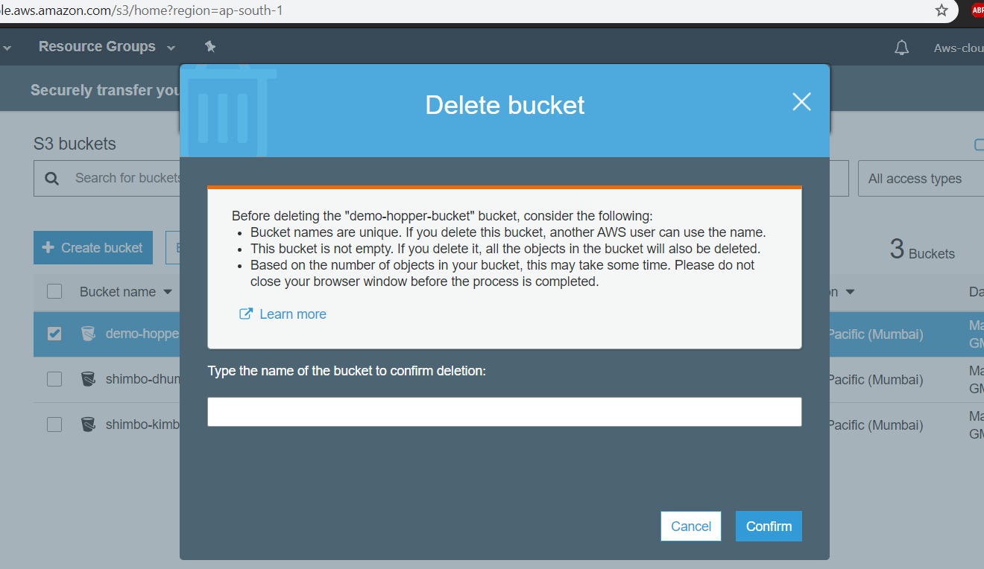
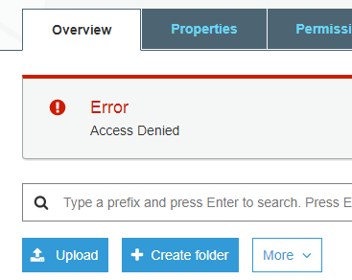
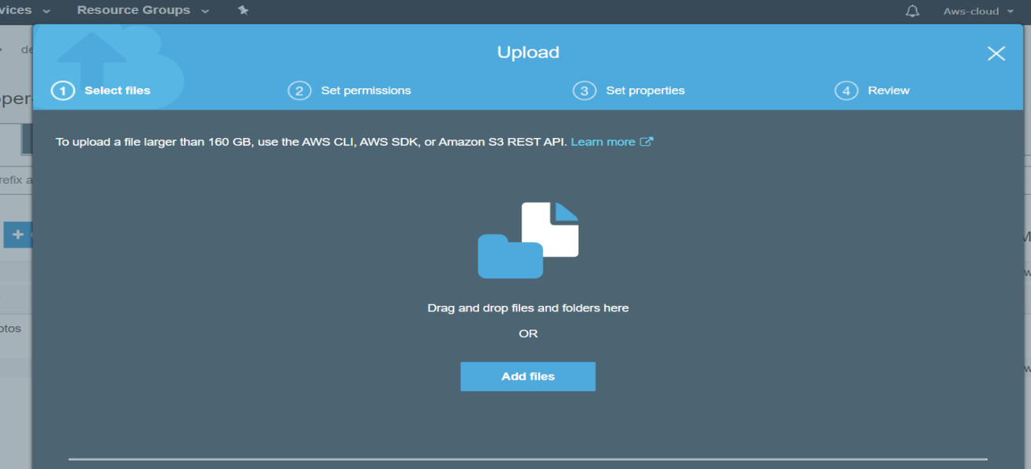
EXISTING SYSTEM SNAPSHOTS
Console asking the user to type the name of the bucket to confirm delete operation, for every delete operation, this confirmation would make it time taking.
To upload a file, user has to set properties and permissions that he/she might ever use only for security purpose.

Slide 5
PROPOSED SYSTEM
Boto3 is a very efficient SDK(Software Development Kit) available which can be used to access and operate S3 buckets without the actual manual process. Boto3 can be integrated with python. A powerful python script which involves everything from authentication of the user to managing s3 buckets operations can be done in the more efficient and time-conservative way than the manual process. Authentication is done by configuring the AWS account by using a root key(.csv) file generated by AWS itself which contains access id and secret key with SSH-256 encryption thus ensuring high data security and integrity of the operation. This enables the users to effectively create and delete buckets, upload files, download a single file or also the whole bucket, list all the buckets and files. remove files and effectively handle the data with very minimal manual work.

Slide 6
SOFTWARE REQUIREMENTS
Operating System : Windows 10/Linux/Unix
Coding Language: Python.
Tool: Python3.8
Editor: Notepad/ Notepad++ /IDLE 3.8
Python packages to be installed : pip(Latest version recommended), python-requests.
SDK: Boto3 1.5.16, botocore-client(for configuration and authentication purpose)
AWS S3 console and Amazon Web Services account.
Command line tool: Windows command prompt or power shell / UBUNTU’s terminal with root user access.

Slide 7
HARDWARE REQUIREMENTS
RAM: 4 GB or Higher
Input Devices: Keyboard, Mouse
Monitor: 15’’ LED
System: Pentium Dual Core
Hard Disk: 500GB
Good active Internet Connection

Slide 8



WHAT IS AMAZON WEB SERVICES(AWS)????
Amazon Web Services(AWS) is one of the world’s best cloud platforms available to developers. It was started in 2005. AWS provides variety of services to developers for working and developing world-defining products. From databases, storage, virtual servers, API, SDK,….AWS provides users with almost every functional service vital in cloud computing. Let us see some of the services provided by AWS.
Elastic Compute Cloud(EC2) : Provides Virtual Servers to users.
Simple Storage Service(S3) : Scalable Object Storage Service.
DynamoDB : Flexible Database that can be integrated in any application.
RedShift : Used for DATAWAREHOUSING.

Slide 9
SIMPLE STORAGE SERVICE(S3)
Amazon S3 is a flexible object storage available to users which can be used for different purposes like storing configuration files, integration with web and mobile applications, management data of industries etc.. Many leading organizations like spotify, TCS, Netflix use S3 in their everyday work. S3 provides storage up to 5TB and data is stored in S3 Storage buckets with high security. Users can upload a maximum of one GB file in a single upload. Users can also configure the security of their data by providing security controls to each data bucket. Data in S3 can be archived to AWS Glacier (A VERY EFFICIENT ARCHIVAL SERVICE) and can be used anytime.

Slide 10
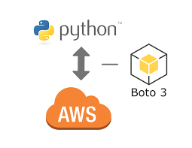
BOTO3 – AWS SDK for PYTHON
Boto3 is a very efficient SDK that has been developed for python scripts. This SDK mainly operates on various services of AWS like EC2, S3 etc. Using Boto3 and configuring and using it with python scripts, users can access services of AWS and also perform many operations with just few lines of code without any manual work. For ex: We can use Boto3 for EC2( Starting and stopping the servers, permissions etc) and also for performing a lot of data- related operations on S3.

Slide 11
MODULES
User Credentials Authentication.
Data Bucket Creation.
Data Bucket Deletion.
Object Files Uploading.
Object Files Downloading.
Object Files Deletion.
Generating Pre-Signed URL
Reading files directly from S3

Slide 12
User Credentials Authentication: In this module, the credentials provided by the user to connect to the S3 console and perform operations, are verified and authenticated.
Data Bucket Creation: In this module, Data buckets are created for the following user in suitable availability zone.
Data Bucket Deletion: In this module, user can delete the entire data bucket (or) delete all the contents of the bucket and retain that bucket for future purposes.
Object files uploading: In this module, user can upload files into the prescribed data bucket and this also supports single-file upload and multiple file upload.
Object files Downloading: In this module, the data files are downloaded into the host system on the choice of the user – can be a single file download (or) multi-file download.
Object files Deletion: In this module, user can delete files and subfolders in the selected data bucket.

Slide 13
Boto3.Resource
In the Boto3 SDK, Boto3.Resource is one of the most important package to make this SDK a huge success. Boto3.resource is a secured, high-level abstracted Object oriented interface to the AWS service. In the backend, it contains code that involves SSL(Secured Socket Layer) request calls and networking modules. The s3.resource takes the credentials parameters and sets up an interface with the respective service console. This is the primary step in the working of boto3, setting up a secured connection with the entity. The Syntax of s3.resource is as follows:
S3 = boto3.resource(“SERVICE”(EC2/S3), “AWS_ACCESS_ID”,”SECRET_KEY",{‘Location Constraint’: ###,config = Config(signature version = ‘####’))

Slide 14
FUNCTIONAL REQUIREMENTS
The system after careful analysis has been identified to be presented with the following requirements:
Create a secured connection with AWS S3 service.
Credentials Authentication should be accurate, invalid credentials must raise error.
Pre-signed URL when generated should not raise ERROR [400] (or) crash.
Bucket creation must be done in the specified availability zone and permissions must match.

Slide 15
Bucket creation must following the AWS Bucket naming convention and must raise a error when fails.
Data Bucket deletion must not compromise the object files inside it.
Reading files from S3 directly should not be in raw stream and must be encoded.
Object files operations must not interfere with security of the bucket and should be accurate

Slide 16
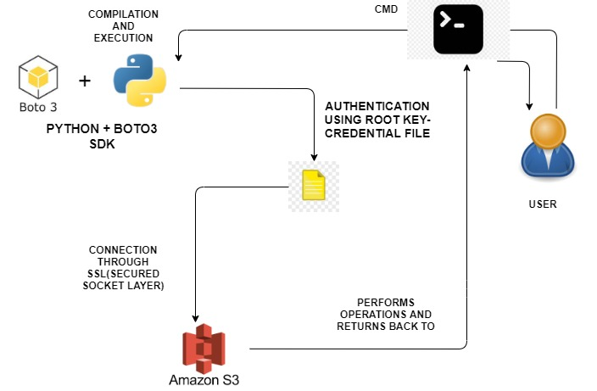
ARCHITECTURE

Slide 17
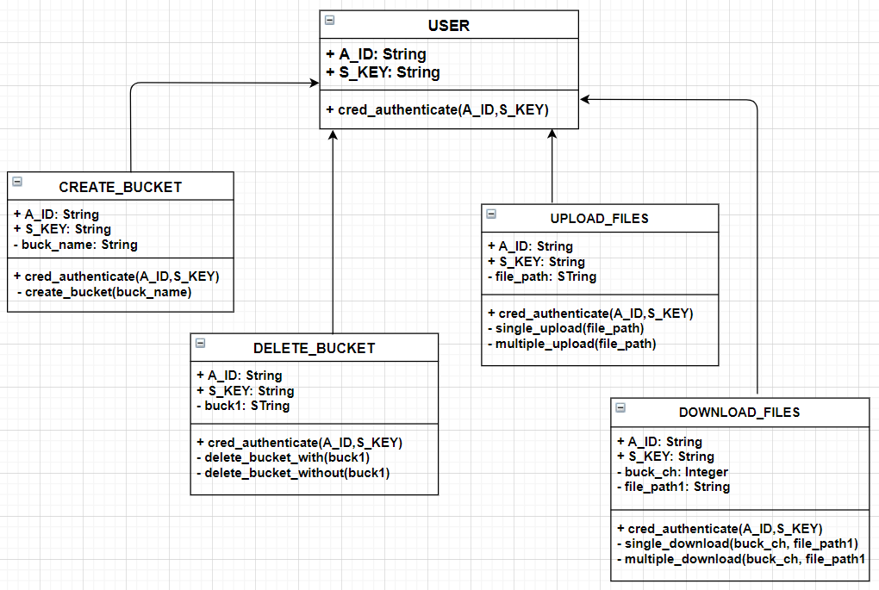
CLASS DIAGRAM

Slide 18
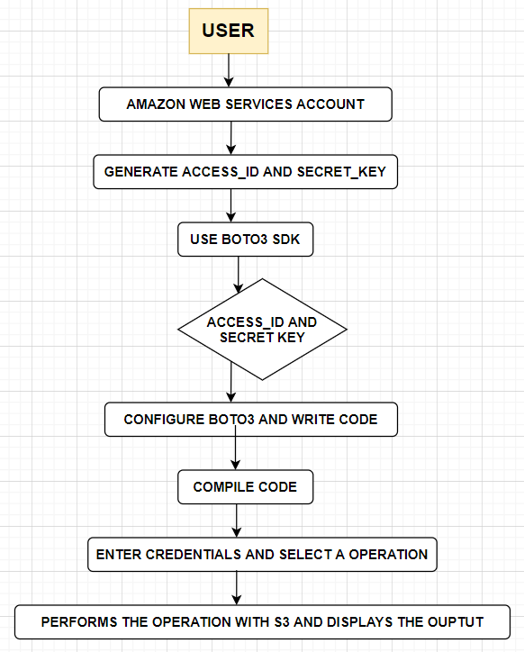
DATA-FLOW DIAGRAM

Slide 19
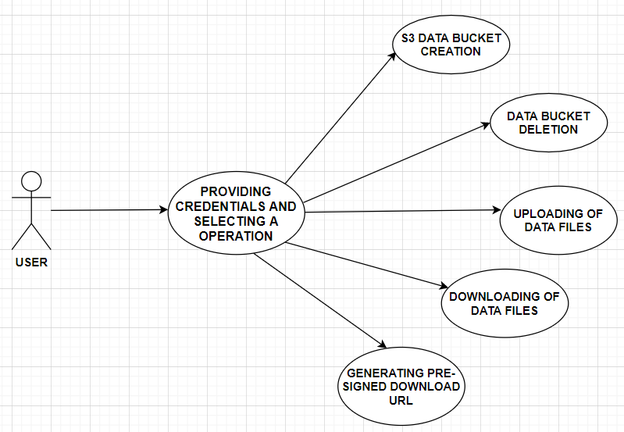
USE-CASE DIAGRAM

Slide 20
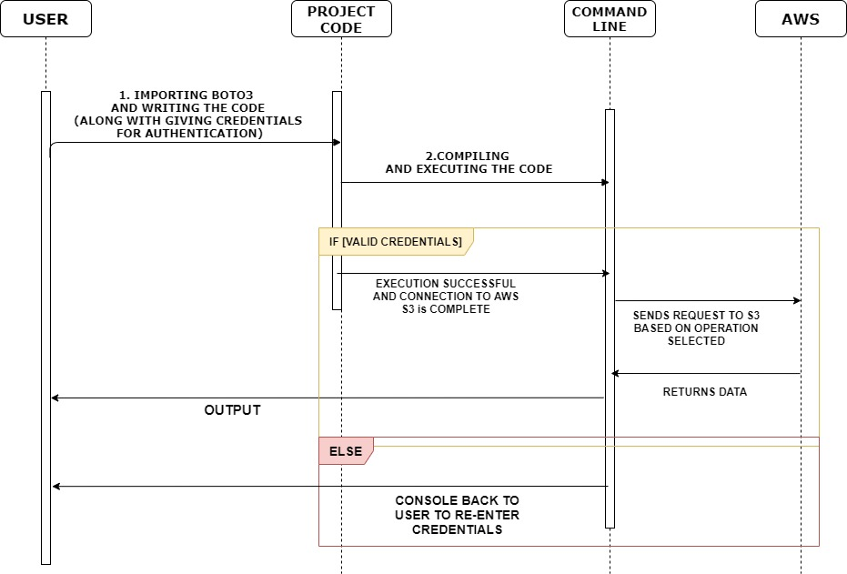
SEQUENCE DIAGRAM

Slide 21
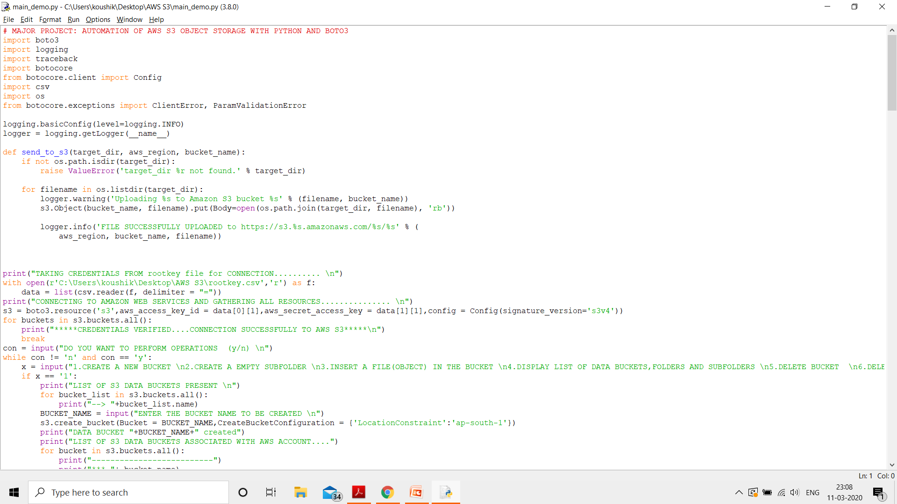
CODE SNIPPETS

Slide 22
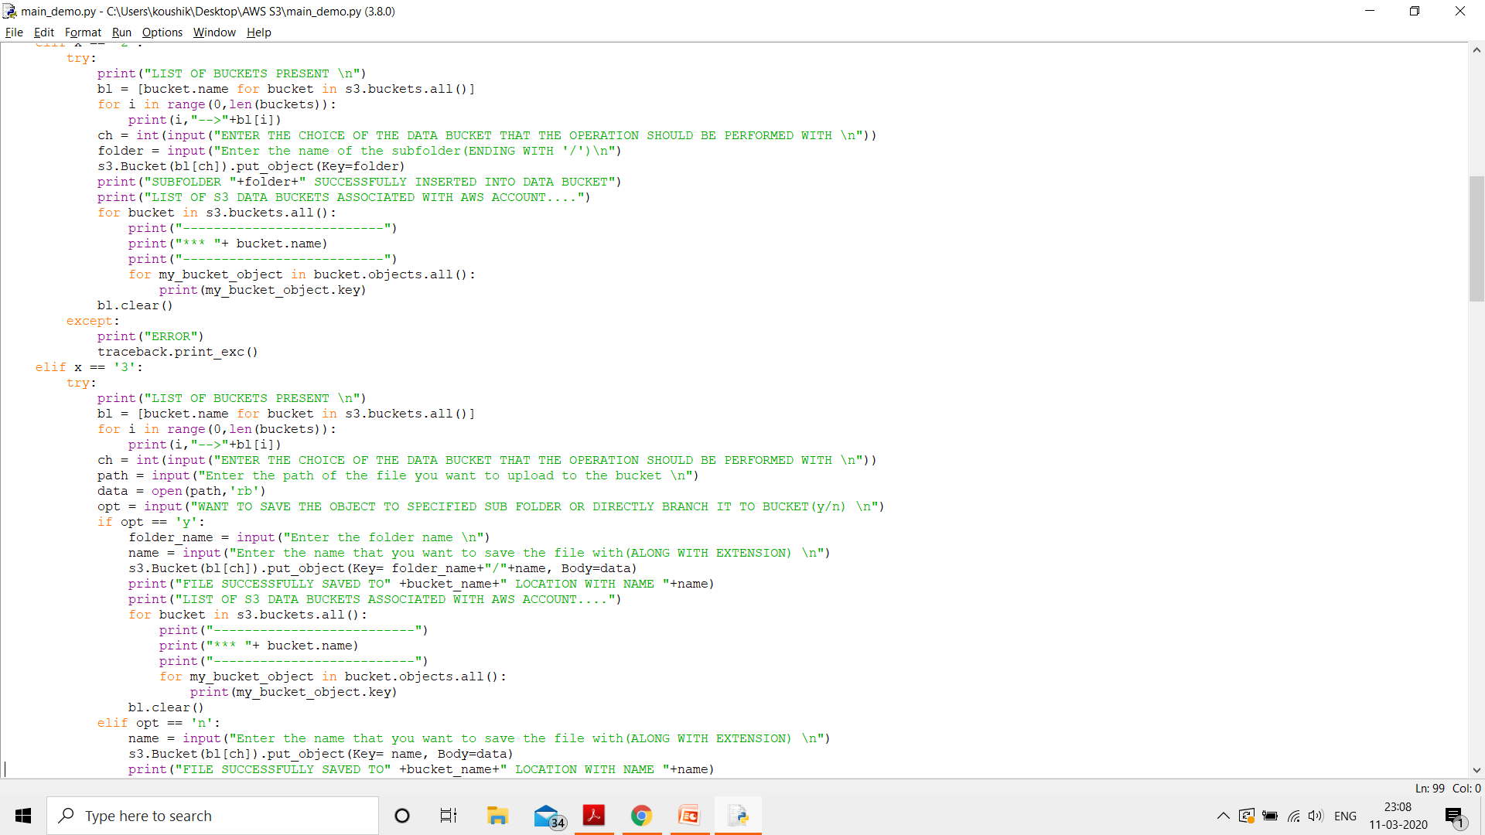

Slide 23
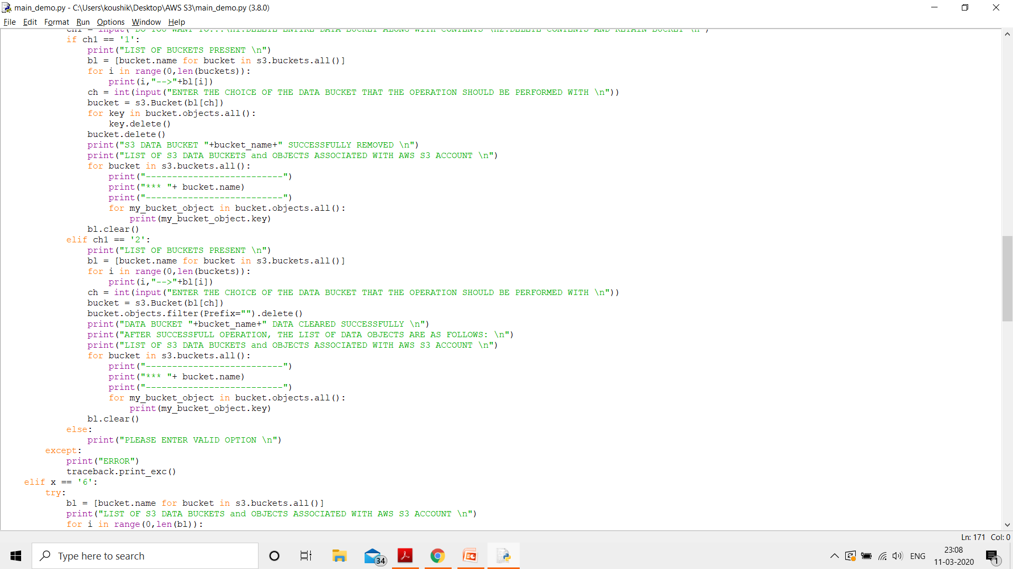

Slide 24
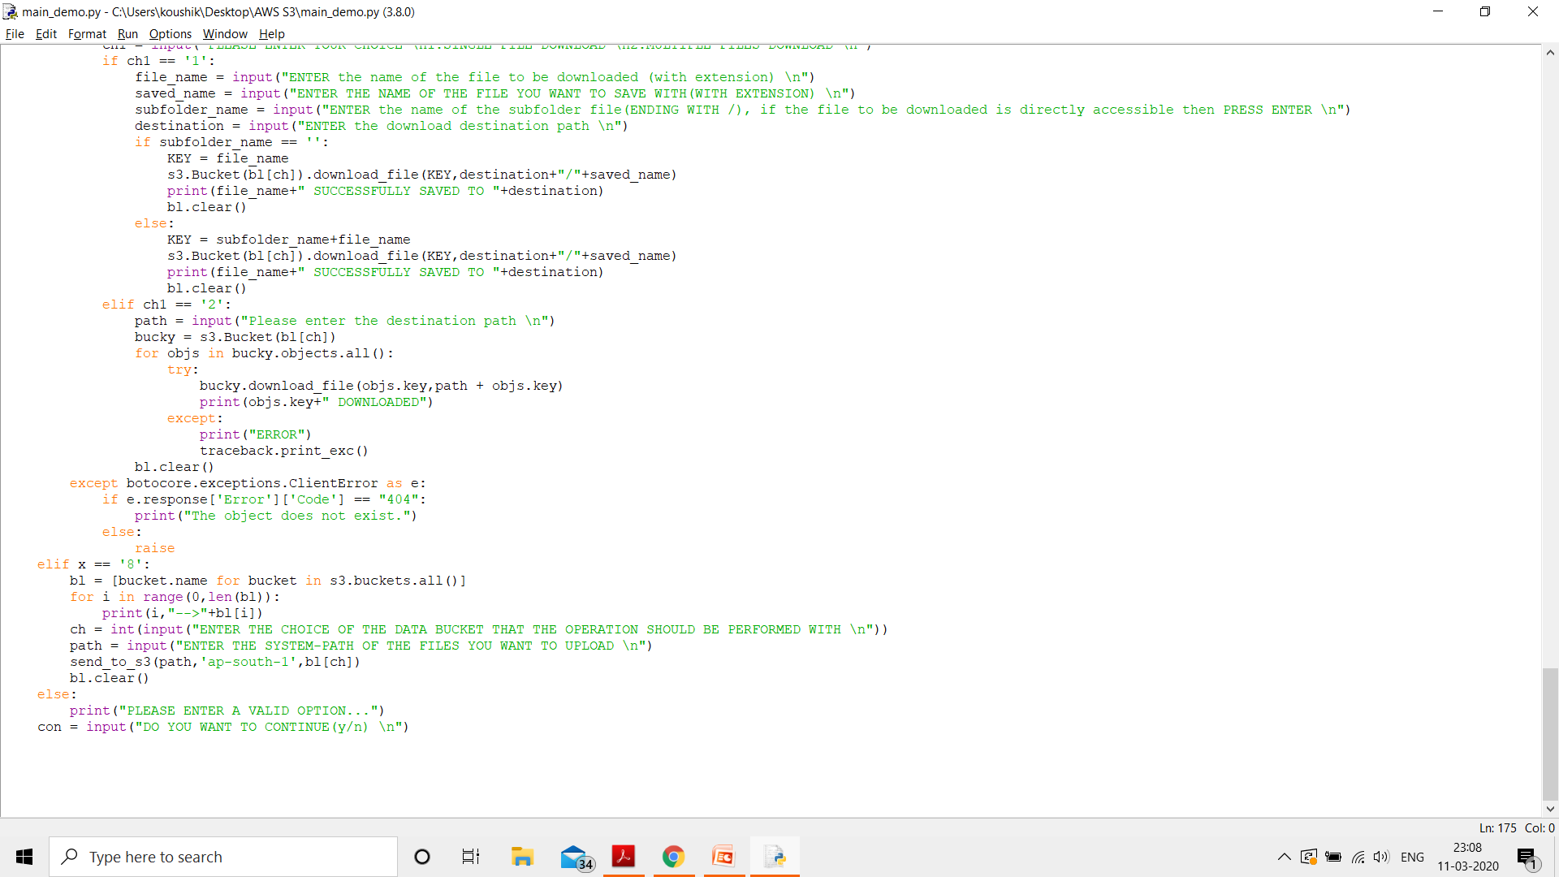

Slide 25
TESTING
TEST STRATEGY AND APPROACH:
Testing will be performed manually and functional tests will be written in detail.
TEST OBJECTIVES:
Boto3 connection must be secure
Data bucket creation, deletion should be correctly
done without loss of data.
Object files upload, download, delete, permissions should be accurate.
Files reading from S3 directly cannot be in raw stream
FEATURES TO BE TESTED:
Connection must be established only for valid credentials
Pre- Signed URL should not revoke https:// [400] error

Slide 26
Integration Testing is a level of software testing where individual units are combined and tested as a group. The purpose of this level of testing is to expose faults in the interaction between integrated units.
TEST RESULTS:
All the test cases mentioned above passed successfully. No defects encountered.
ACCEPTANCE TESTING
User Acceptance Testing is a critical phase of any project and requires significant participation by the end user.

Slide 27
T.NO | TEST DATA | TEST DESCRIPTION | EXPECTED RESULT | ACTUAL RESULT | STATUS
TC - 01 | Valid Root key file | Checking for authentication | Successful Connection | Successful Connection | Pass
TC - 01 | Invalid Root key file | Checking for authentication | Credentials Validation Error | Invalid credentials | Pass
TC-02 | Data Bucket | Bucket creation and deletion | Success | Bucket operations are successful | Pass
TC-03 | Object file | Pres-signed url | Pre-signed url is generated | SUCCESSFUL | Pass
TC-04 | Wrong Bucket naming convention | Bucket creation using invalid bucket name | Program stops running. | Error, program continued to ask inputs. | Fail

Slide 28
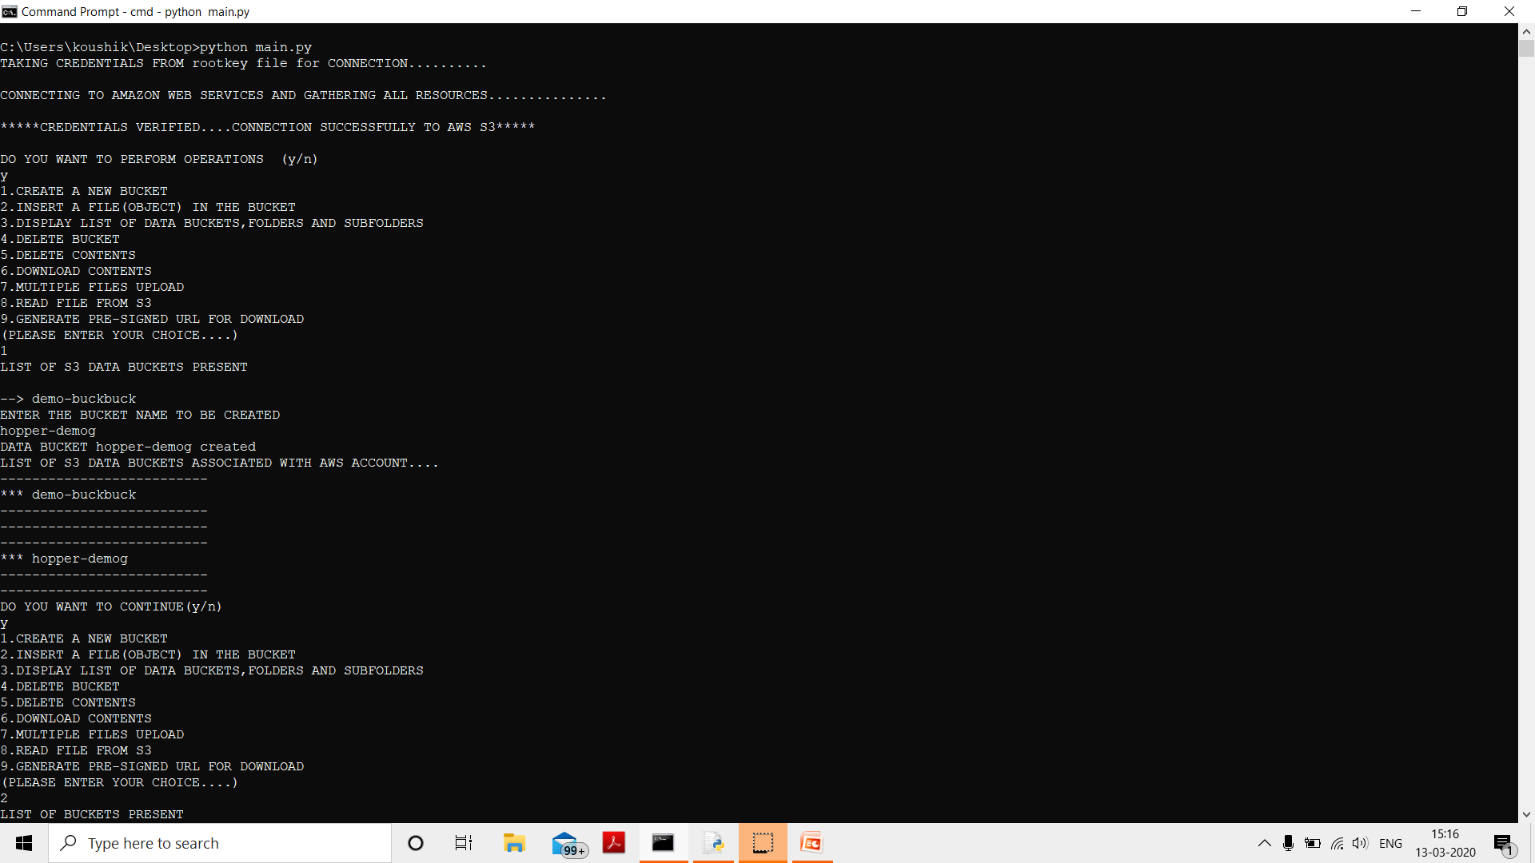
OUTPUT

Slide 29
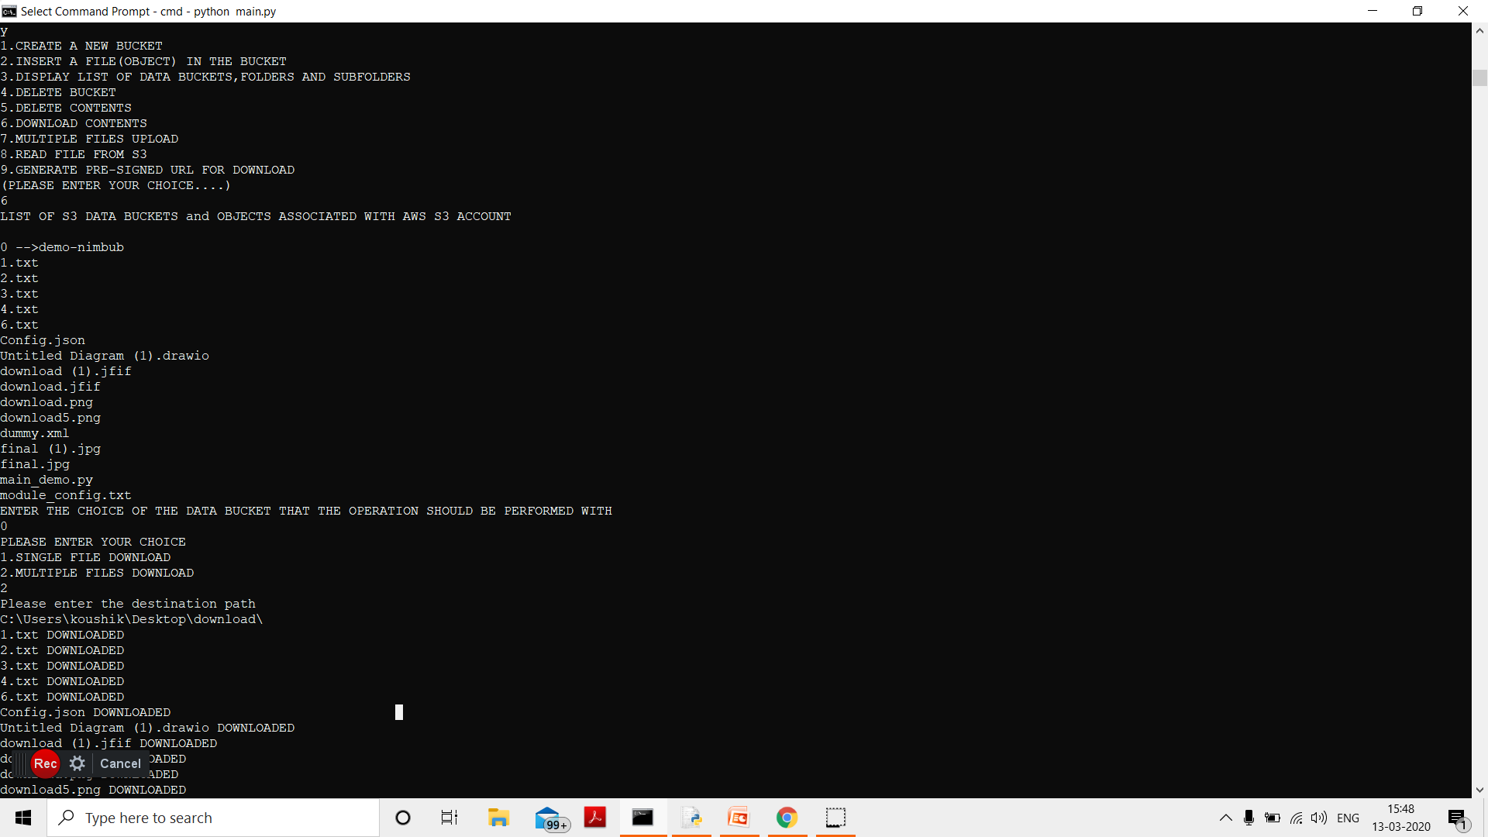

Slide 30
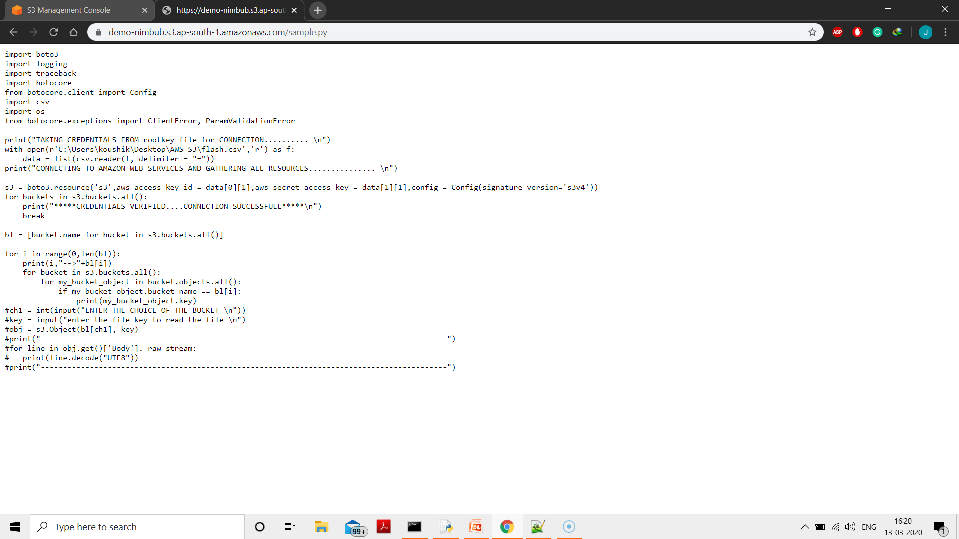

Slide 31
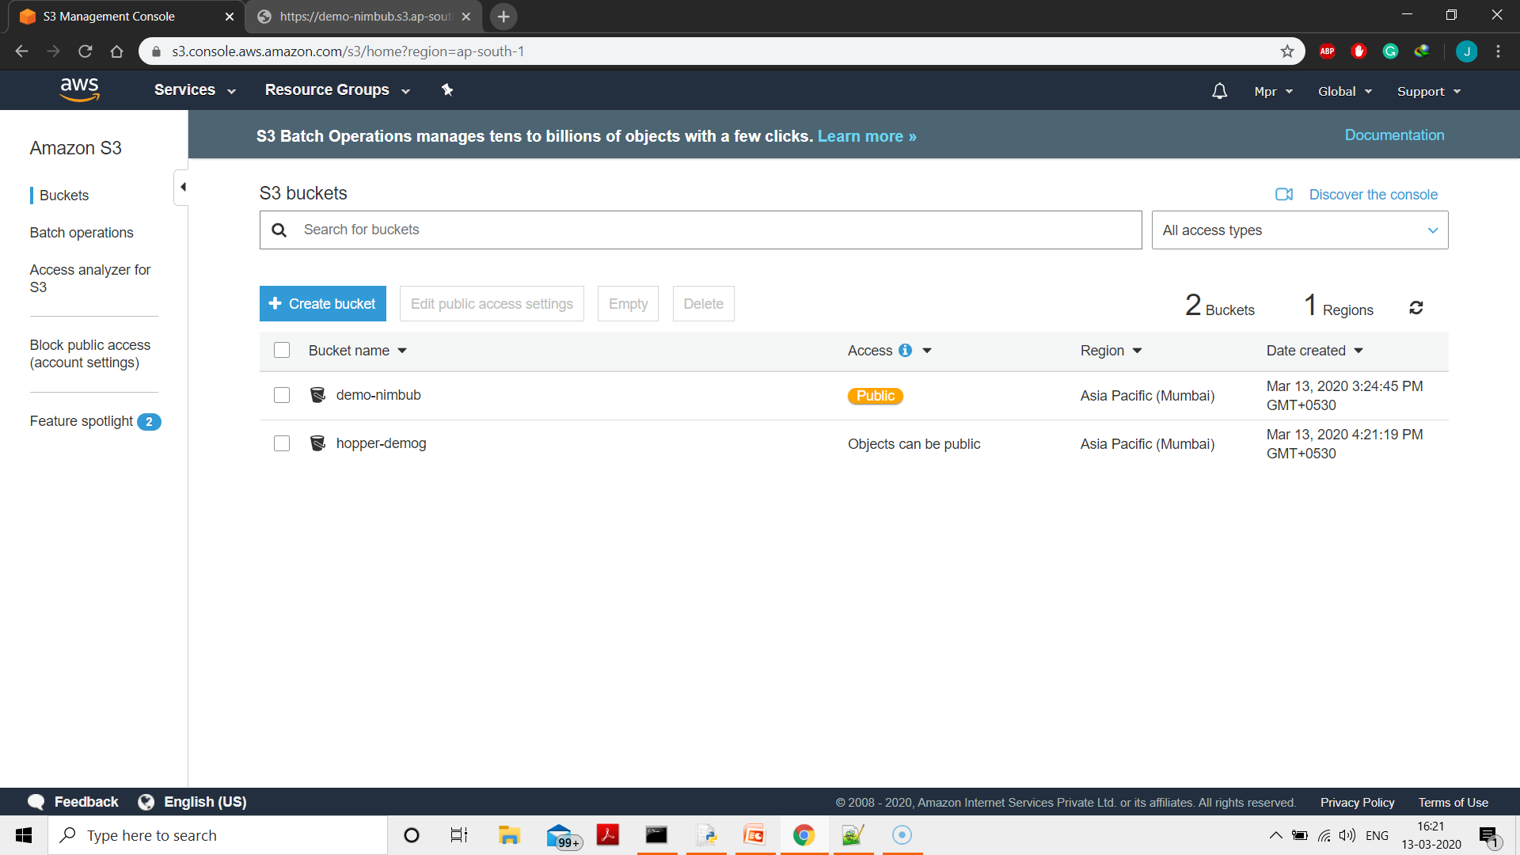

Slide 32
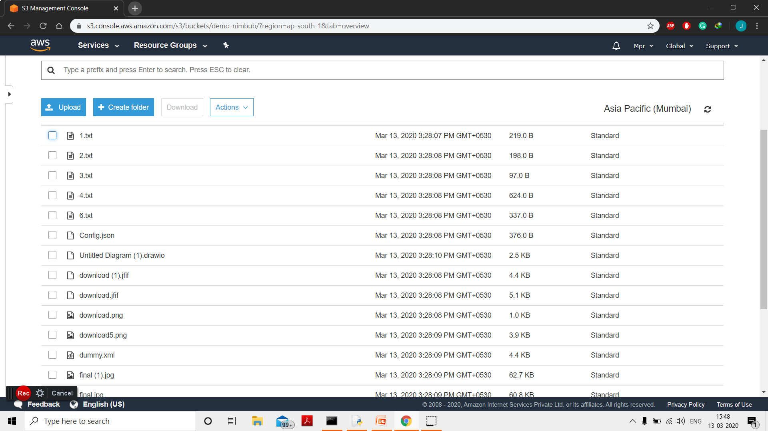

Slide 33
BIBLIOGRAPHY
Mike's Guides to Learning Boto3 Volume 1: Amazon AWS Connectivity and Basic VPC Networking
Amazon Web Services in working - Michael wittin
Amazon AWS Cookbook - UDEMY
Learning AWS - Amit Shah
Gerardus Blokdyk - Amazon S3 and Amazon Glacier The Ultimate Step-By-Step Guide

Slide 34
REFERENCES
Boto3-AWS SDK for Python
https://www.google.com/url?sa=t&source=web&rct=j&url=https://aws.amazon.com/sdk-for-python/&ved=2ahUKEwihgfnG25HoAhUBXSsKHRUxAsUQFjABegQIAxAB&usg=AOvVaw3PZzQlJR3VEBhxdDCaYPdb
Boto3 and Pypi https://pypi.org/project/boto3/
Working with Boto3 and S3 https://towardsdatascience.com/aws-and-python-the-boto3-package-df495bb29cb3

Slide 35
THANK YOU

